Slide 1

Dynamic Models
MTH 564 – Mathematical Modeling

Slide 2
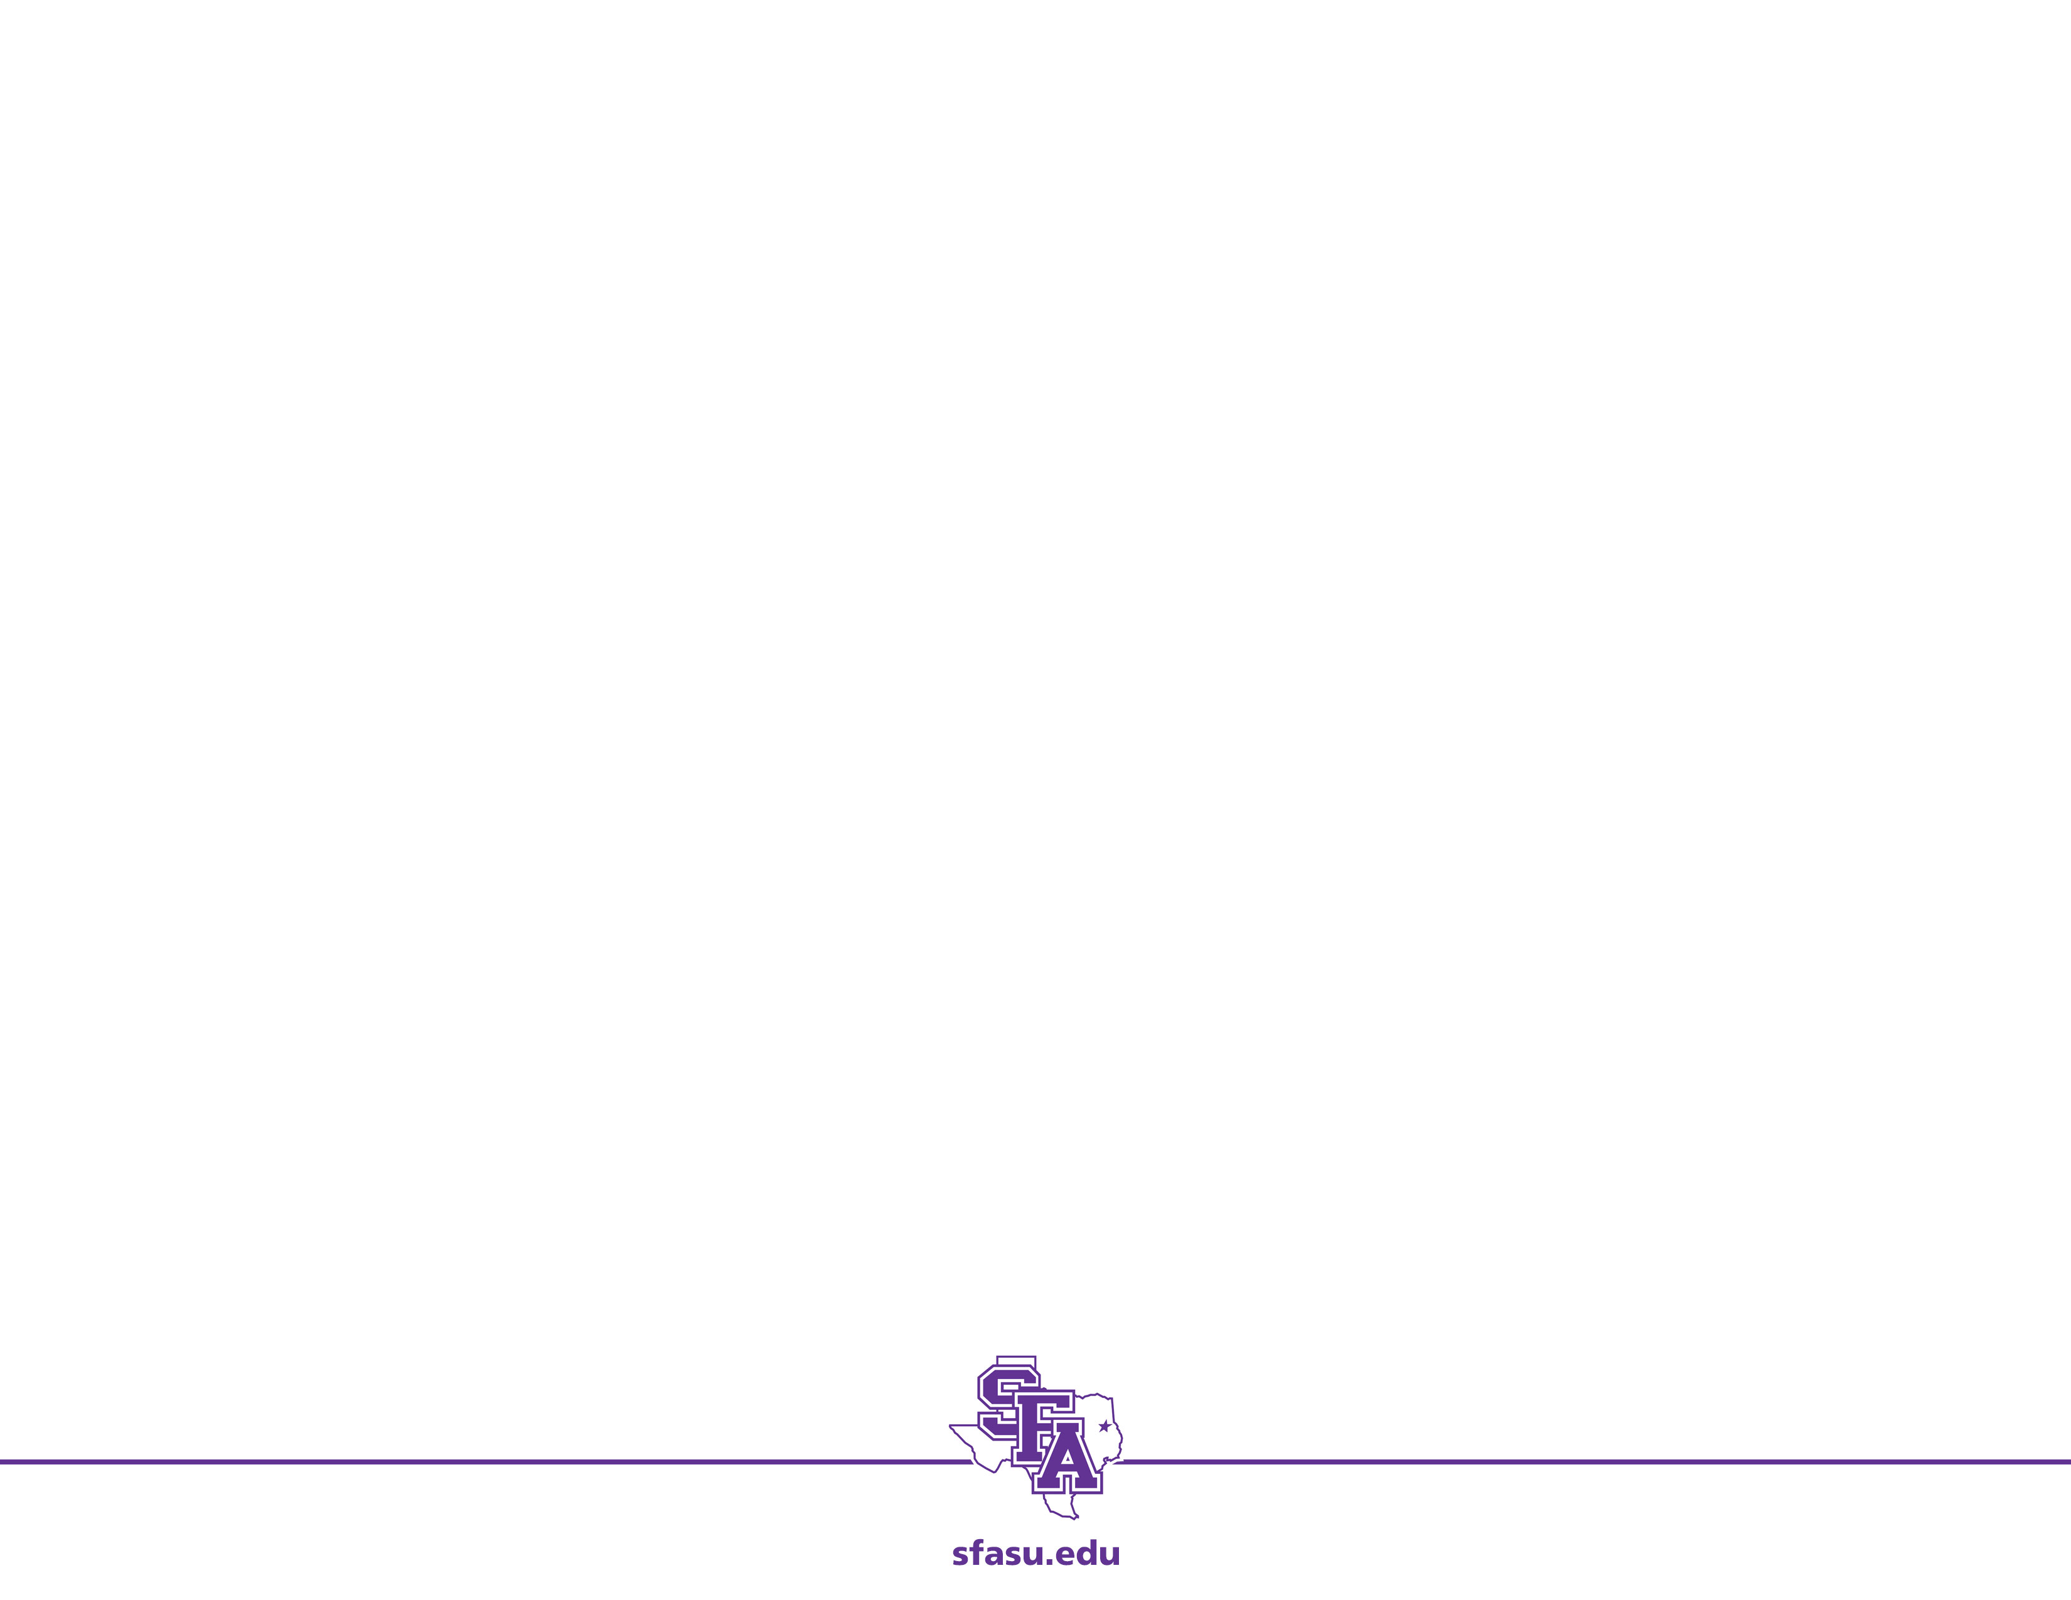
Dynamic Systems: Overview
Can be used to describe the changing behavior of a system that evolves over time
Areas of use
Electric circuits
Space flight
Chemical reactions
Population growth
Investments
Disease spread
Pollution control

Slide 3
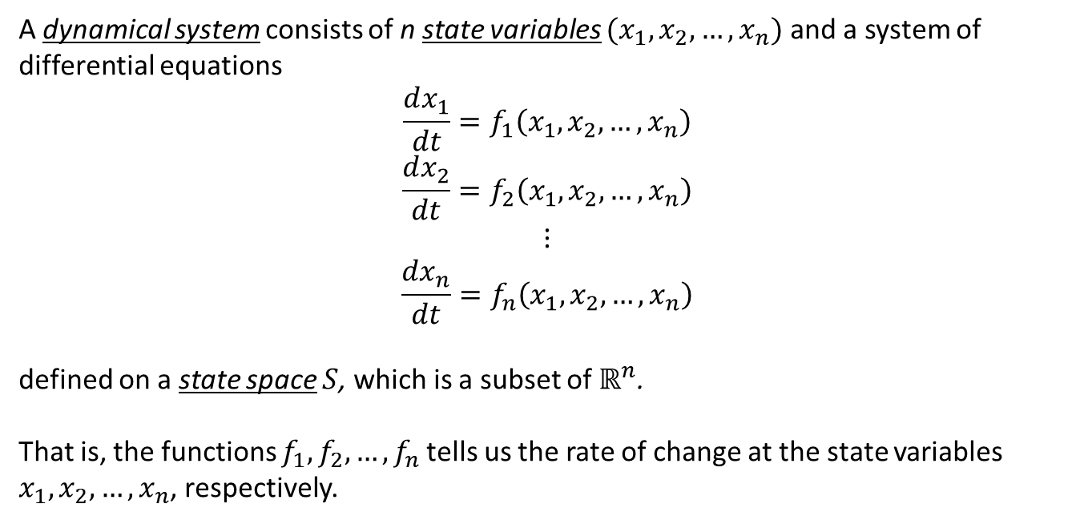
Dynamic Systems: Terminology
A dynamical system consists of n state variables $(x_{1},x_{2},…,x_{n})$ and a system of differential equations
$$\frac{dx_{1}}{dt}=f_{1}\left(x_{1},x_{2},…,x_{n}\right)$$
$$\frac{dx_{2}}{dt}=f_{2}\left(x_{1},x_{2},…,x_{n}\right)$$
$$⋮$$
$$\frac{dx_{n}}{dt}=f_{n}\left(x_{1},x_{2},…,x_{n}\right)$$
defined on a state space $S$, which is a subset of $ℝ^{n}$.
That is, the functions $f_{1}, f_{2},…,f_{n}$tells us the rate of change at the state variables $x_{1},x_{2},…,x_{n}$, respectively.

Slide 4
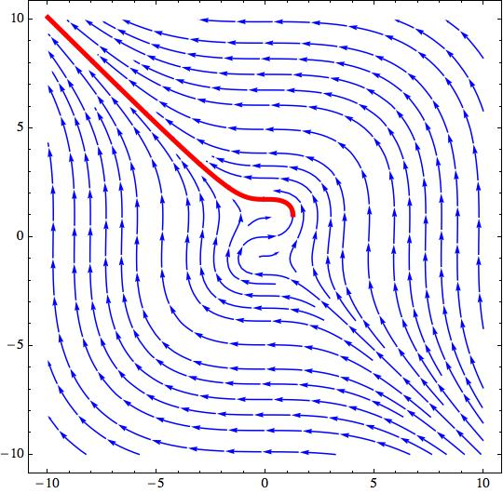
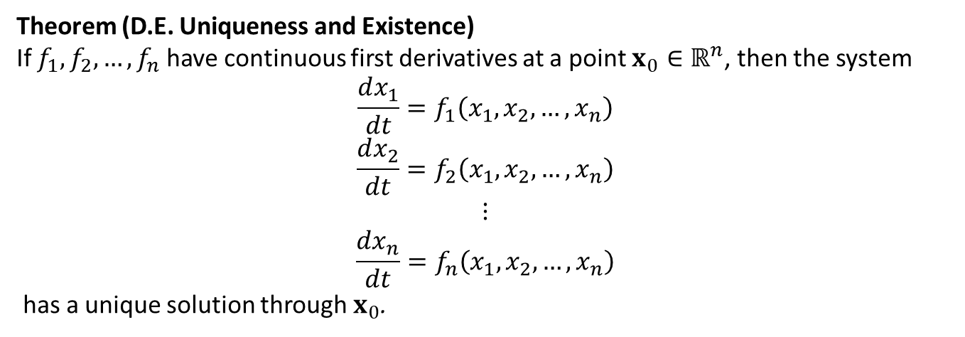
Dynamic Systems: Terminology
Theorem (D.E. Uniqueness and Existence)
If $f_{1}, f_{2},…,f_{n}$ have continuous first derivatives at a point ${x_{0}∈ℝ}^{n}$, then the system
$$\frac{dx_{1}}{dt}=f_{1}\left(x_{1},x_{2},…,x_{n}\right)$$
$$\frac{dx_{2}}{dt}=f_{2}\left(x_{1},x_{2},…,x_{n}\right)$$
$$⋮$$
$$\frac{dx_{n}}{dt}=f_{n}\left(x_{1},x_{2},…,x_{n}\right)$$
has a unique solution through $x_{0}$.
Geometrically we think of these solutions as paths in the state space.
The figure to the right shows solutions corresponding to different initial conditions.
Uniqueness of solutions guarantees paths do not cross.

Slide 5
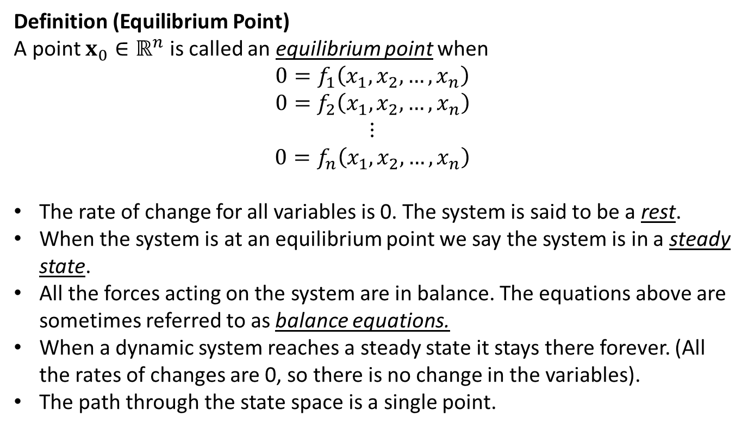
Dynamic Systems: Terminology
Definition (Equilibrium Point)
A point ${x_{0}∈ℝ}^{n}$ is called an equilibrium point when
$$0=f_{1}\left(x_{1},x_{2},…,x_{n}\right)$$
$$0=f_{2}\left(x_{1},x_{2},…,x_{n}\right)$$
$$⋮$$
$$0=f_{n}\left(x_{1},x_{2},…,x_{n}\right)$$
The rate of change for all variables is 0. The system is said to be a rest.
When the system is at an equilibrium point we say the system is in a steady state.
All the forces acting on the system are in balance. The equations above are sometimes referred to as balance equations.
When a dynamic system reaches a steady state it stays there forever. (All the rates of changes are 0, so there is no change in the variables).
The path through the state space is a single point.

Slide 6
Example: Competitive Species
In an unmanaged track of forest hardwood and softwood compete for land and water resources. The more desirable hardwood trees grow more slowly but are more durable and produce more valuable timber. Softwood trees compete with hardwoods by growing rapidly and consuming the available water soil nutrients. Hardwoods compete by growing taller than softwoods can and shading new seedlings. Hardwoods are also more resistant to disease. Can these two types of trees coexist on one tract of forest indefinitely, or will one type of tree drive the other to extinction?

Slide 7
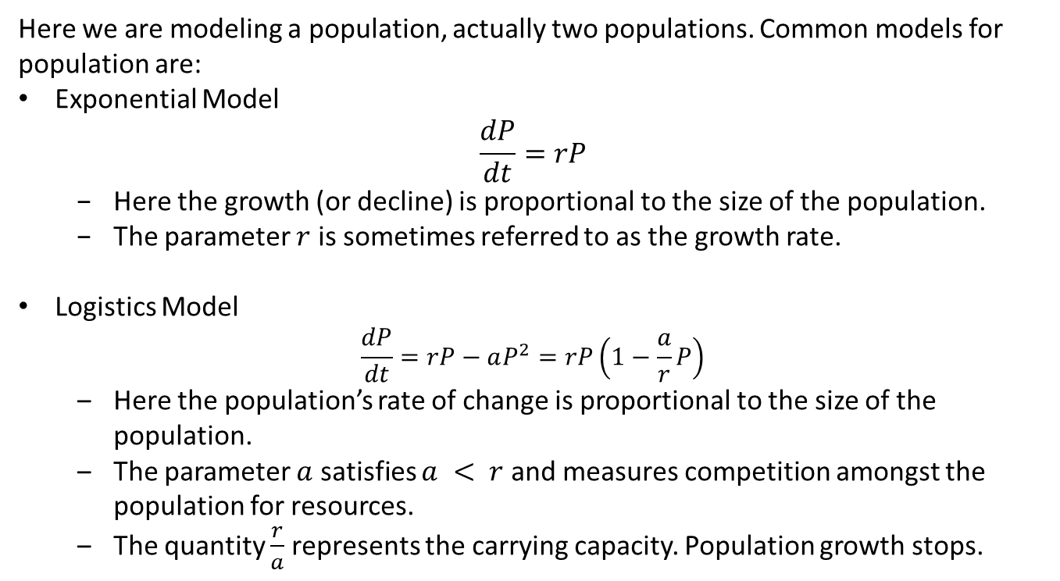
Example: Population Models
Here we are modeling a population, actually two populations. Common models for population are:
Exponential Model $\frac{dP}{dt}=rP$
Here the growth (or decline) is proportional to the size of the population.
The parameter $r$ is sometimes referred to as the growth rate.
Logistics Model $\frac{dP}{dt}=rP−aP^{2}=rP\left(1−\frac{a}{r}P\right)$
Here the population’s rate of change is proportional to the size of the population.
The parameter $a$ satisfies $a < r$ and measures competition amongst the population for resources.
The quantity $\frac{r}{a}$ represents the carrying capacity. Population growth stops.

Slide 8
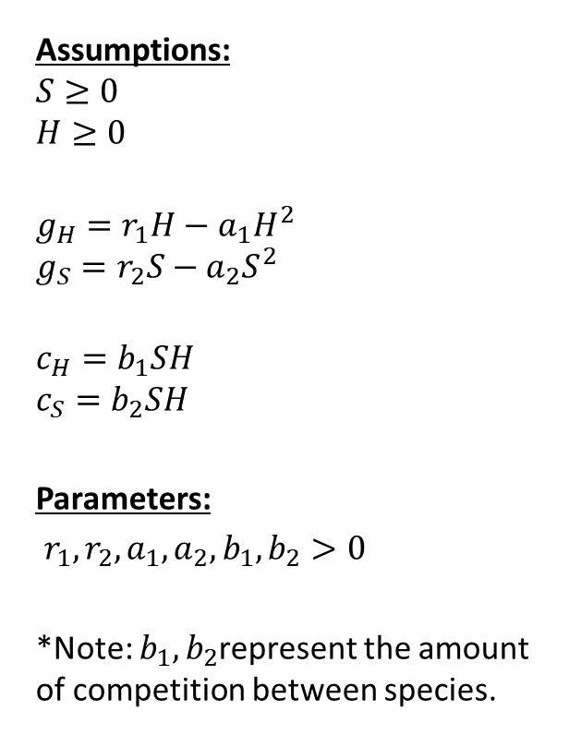
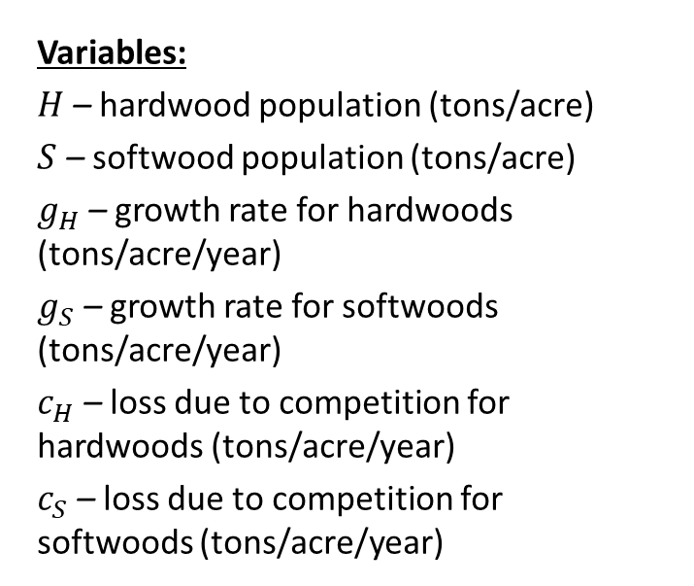
Step 1: Ask the question.
Variables:
$H$ – hardwood population (tons/acre)
$S$ – softwood population (tons/acre)
$g_{H}$ – growth rate for hardwoods (tons/acre/year)
$g_{S}$ – growth rate for softwoods (tons/acre/year)
$c_{H}$ – loss due to competition for hardwoods (tons/acre/year)
$c_{S}$ – loss due to competition for softwoods (tons/acre/year)
Assumptions:
$$S≥0$$
$$H≥0$$
$$g_{H}=r_{1}H−a_{1}H^{2}$$
$$g_{S}=r_{2}S−a_{2}S^{2}$$
$$c_{H}=b_{1}SH$$
$$c_{S}=b_{2}SH$$
Parameters:
$r_{1},r_{2}, a_{1},a_{2},b_{1},b_{2}>0$
*Note: $b_{1},b_{2}$represent the amount of competition between species.
Objective
Determine whether H or S approach 0

Slide 9
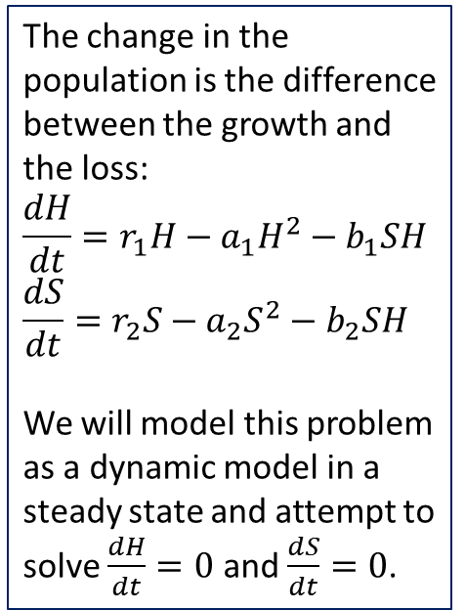
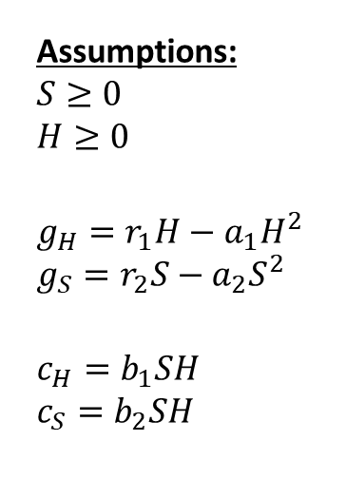
Step 2: Select the modeling approach
Variables:
$H$ – hardwood population (tons/acre)
$S$ – softwood population (tons/acre)
$g_{H}$ – growth rate for hardwoods (tons/acre/year)
$g_{S}$ – growth rate for softwoods (tons/acre/year)
$c_{H}$ – loss due to competition for hardwoods (tons/acre/year)
$c_{S}$ – loss due to competition for softwoods (tons/acre/year)
Assumptions:
$$S≥0$$
$$H≥0$$
$$g_{H}=r_{1}H−a_{1}H^{2}$$
$$g_{S}=r_{2}S−a_{2}S^{2}$$
$$c_{H}=b_{1}SH$$
$$c_{S}=b_{2}SH$$
The change in the population is the difference between the growth and the loss:
$$\frac{dH}{dt}=r_{1}H−a_{1}H^{2}−b_{1}SH$$
$$\frac{dS}{dt}=r_{2}S−a_{2}S^{2}−b_{2}SH$$
We will model this problem as a dynamic model in a steady state and attempt to solve $\frac{dH}{dt}=0$ and $\frac{dS}{dt}=0$.
Objective
Determine whether H or S approach 0

Slide 10
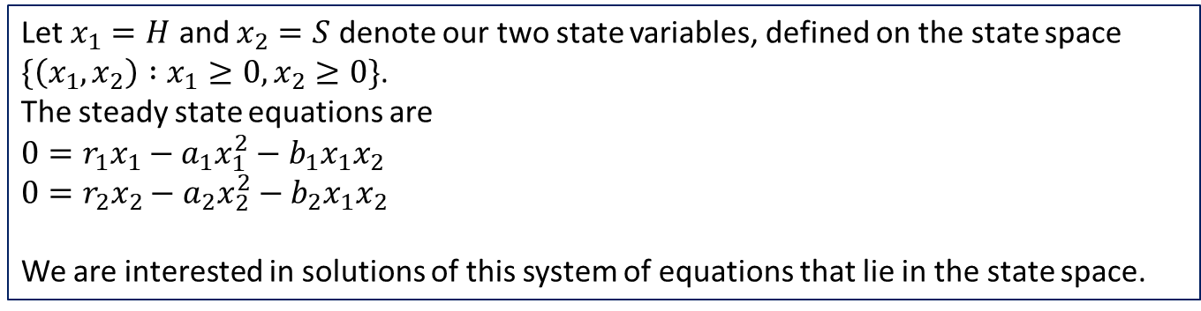
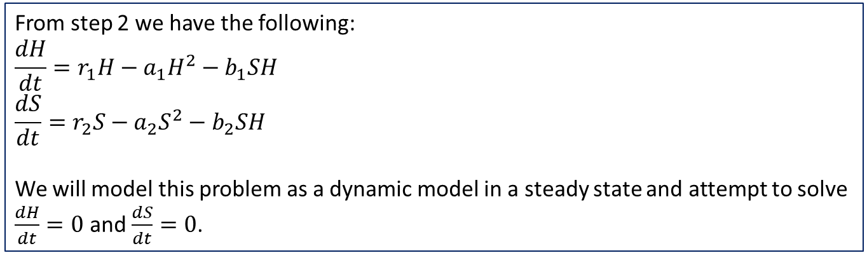
Step 3: Formulate the model
From step 2 we have the following:
$$\frac{dH}{dt}=r_{1}H−a_{1}H^{2}−b_{1}SH$$
$$\frac{dS}{dt}=r_{2}S−a_{2}S^{2}−b_{2}SH$$
We will model this problem as a dynamic model in a steady state and attempt to solve $\frac{dH}{dt}=0$ and $\frac{dS}{dt}=0$.
Let $x_{1}=H$ and $x_{2}=S$ denote our two state variables, defined on the state space
$\{\left(x_{1},x_{2}\right) :x_{1}≥0, x_{2}≥0\}$.
The steady state equations are
$$0=r_{1}x_{1}−a_{1}x_{1}^{2}−b_{1}x_{1}x_{2}$$
$$0=r_{2}x_{2}−a_{2}x_{2}^{2}−b_{2}x_{1}x_{2}$$
We are interested in solutions of this system of equations that lie in the state space.

Slide 11
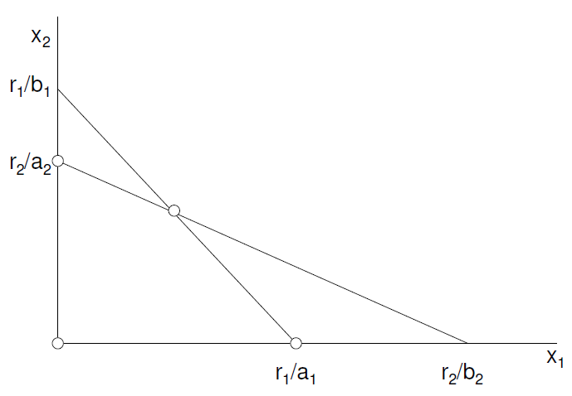
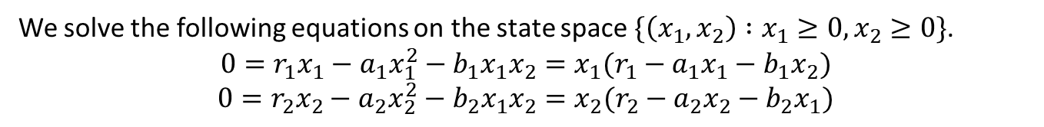
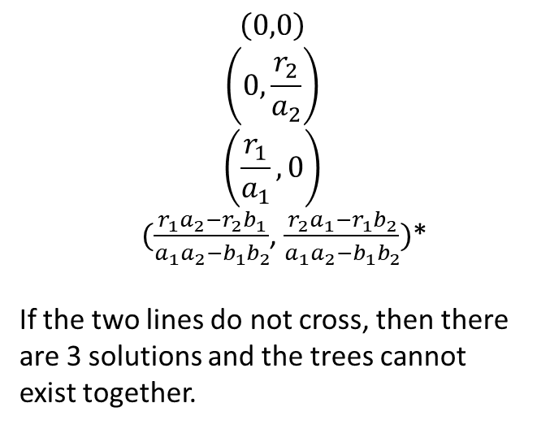
Step 4: Solve the Problem
We solve the following equations on the state space $\{\left(x_{1},x_{2}\right) :x_{1}≥0, x_{2}≥0\}$.
$$0=r_{1}x_{1}−a_{1}x_{1}^{2}−b_{1}x_{1}x_{2}=x_{1}(r_{1}−a_{1}x_{1}−b_{1}x_{2})$$
$$0=r_{2}x_{2}−a_{2}x_{2}^{2}−b_{2}x_{1}x_{2}=x_{2}(r_{2}−a_{2}x_{2}−b_{2}x_{1})$$
Solving these equations either by hand or using solve function in sympy we get the following solutions:
$$\left(0,0\right)$$
$$\left(0,\frac{r_{2}}{a_{2}}\right)$$
$$\left(\frac{r_{1}}{a_{1}},0\right)$$
$(\frac{r_{1}a_{2}−r_{2}b_{1}}{a_{1}a_{2}−b_{1}b_{2}}$, $\frac{r_{2}a_{1}−r_{1}b_{2}}{a_{1}a_{2}−b_{1}b_{2}})$*
If the two lines do not cross, then there are 3 solutions and the trees cannot exist together.
Notes:
See python file section1-1pig.py

Slide 12

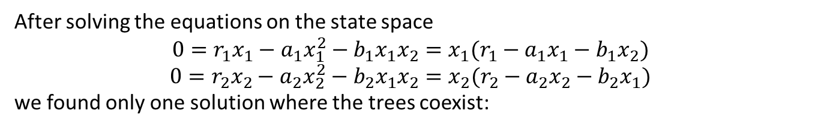
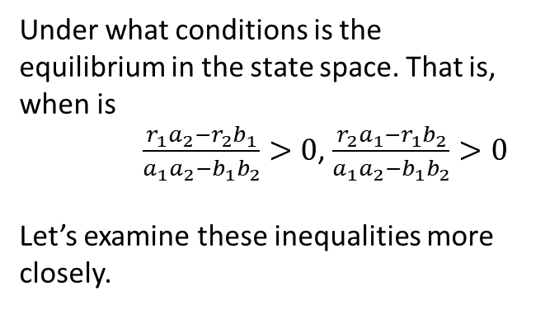
Step 4: Solve the Problem
After solving the equations on the state space
$$0=r_{1}x_{1}−a_{1}x_{1}^{2}−b_{1}x_{1}x_{2}=x_{1}(r_{1}−a_{1}x_{1}−b_{1}x_{2})$$
$$0=r_{2}x_{2}−a_{2}x_{2}^{2}−b_{2}x_{1}x_{2}=x_{2}(r_{2}−a_{2}x_{2}−b_{2}x_{1})$$
we found only one solution where the trees coexist:
Under what conditions is the equilibrium in the state space. That is, when is
$\frac{r_{1}a_{2}−r_{2}b_{1}}{a_{1}a_{2}−b_{1}b_{2}}>0$, $\frac{r_{2}a_{1}−r_{1}b_{2}}{a_{1}a_{2}−b_{1}b_{2}}>0$
Let’s examine these inequalities more closely.
$(\frac{r_{1}a_{2}−r_{2}b_{1}}{a_{1}a_{2}−b_{1}b_{2}}$, $\frac{r_{2}a_{1}−r_{1}b_{2}}{a_{1}a_{2}−b_{1}b_{2}})$
Notes:
See python file section1-1pig.py

Slide 13

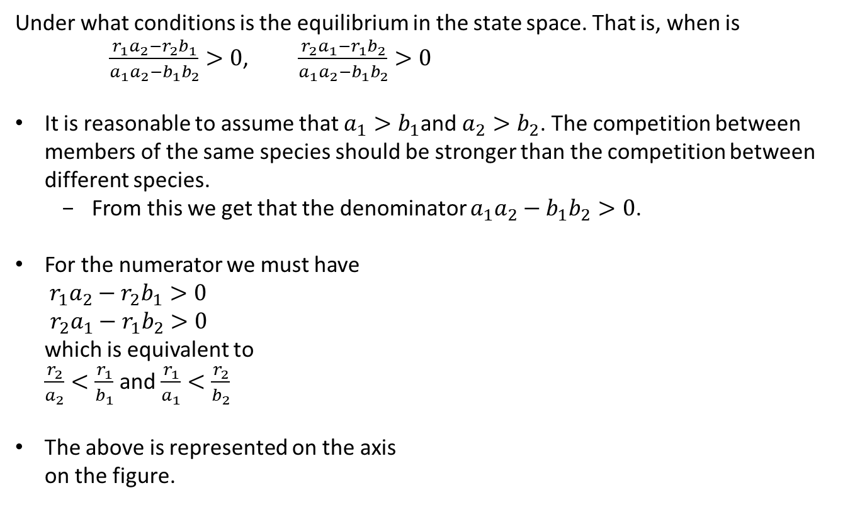
Step 4: Solve the Problem
Under what conditions is the equilibrium in the state space. That is, when is
$\frac{r_{1}a_{2}−r_{2}b_{1}}{a_{1}a_{2}−b_{1}b_{2}}>0$, $\frac{r_{2}a_{1}−r_{1}b_{2}}{a_{1}a_{2}−b_{1}b_{2}}>0$
It is reasonable to assume that $a_{1}>b_{1}$and $a_{2}>b_{2}$. The competition between members of the same species should be stronger than the competition between different species.
From this we get that the denominator $a_{1}a_{2}−b_{1}b_{2}>0$.
For the numerator we must have ${ r}_{1}a_{2}−r_{2}b_{1}>0$ $r_{2}a_{1}−r_{1}b_{2}>0$ which is equivalent to $\frac{r_{2}}{a_{2}}<\frac{r_{1}}{b_{1}}$ and $\frac{r_{1}}{a_{1}}<\frac{r_{2}}{b_{2}}$
The above is represented on the axis on the figure.
$(\frac{r_{1}a_{2}−r_{2}b_{1}}{a_{1}a_{2}−b_{1}b_{2}}$, $\frac{r_{2}a_{1}−r_{1}b_{2}}{a_{1}a_{2}−b_{1}b_{2}})$
Notes:
See python file section1-1pig.py

Slide 14
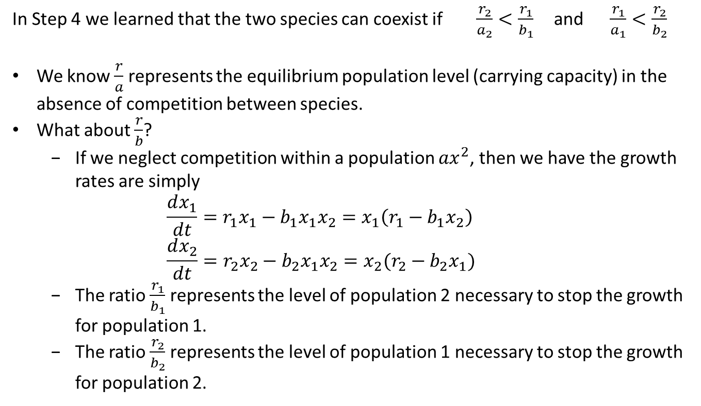
Step 5: Answer the question
In Step 4 we learned that the two species can coexist if $\frac{r_{2}}{a_{2}}<\frac{r_{1}}{b_{1}}$ and $\frac{r_{1}}{a_{1}}<\frac{r_{2}}{b_{2}}$
We know $\frac{r}{a}$ represents the equilibrium population level (carrying capacity) in the absence of competition between species.
What about $\frac{r}{b}$?
If we neglect competition within a population $ax^{2}$, then we have the growth rates are simply ${\frac{dx_{1}}{dt}=r}_{1}x_{1}−b_{1}x_{1}x_{2}=x_{1}\left(r_{1}−b_{1}x_{2}\right)$ ${\frac{dx_{2}}{dt}=r}_{2}x_{2}−b_{2}x_{1}x_{2}=x_{2}(r_{2}−b_{2}x_{1})$
The ratio $\frac{r_{1}}{b_{1}}$ represents the level of population 2 necessary to stop the growth for population 1.
The ratio $\frac{r_{2}}{b_{2}}$ represents the level of population 1 necessary to stop the growth for population 2.

Slide 15
Step 5: Answer the question
In Step 5 we learned that the two species can coexist if $\frac{r_{2}}{a_{2}}<\frac{r_{1}}{b_{1}}$ and $\frac{r_{1}}{a_{1}}<\frac{r_{2}}{b_{2}}$
For each type of tree (hardwood and softwood), there are two kinds of limits to growth
One comes from competition with the other type of tree.
The other comes from competition between trees of same type under crowded conditions.
Thus for each type of there are two points where growth will halt.
One point is due to crowding
The other point is due to competition.
The condition for coexistence of both types is that each type reaches the point where it limits its own growth before it reaches the point where it limits the other’s growth.

Slide 16
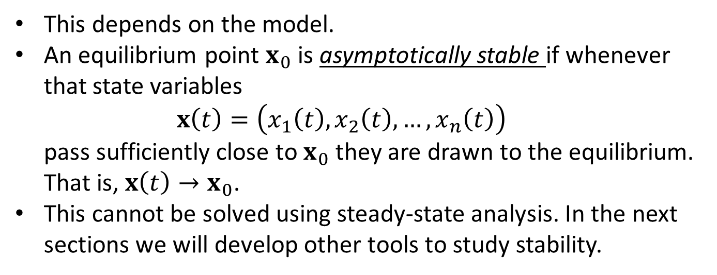
Next
Will the system actually get to the equilibrium solution?
This depends on the model.
An equilibrium point $x_{0}$ is asymptotically stable if whenever that state variables $x\left(t\right)=\left(x_{1}\left(t\right), x_{2}\left(t\right), …,x_{n}\left(t\right)\right)$ pass sufficiently close to $x_{0}$ they are drawn to the equilibrium. That is, $x\left(t\right)→x_{0}$.
This cannot be solved using steady-state analysis. In the next sections we will develop other tools to study stability.

